Slide 1

PRIVEXUS
Delivery App Communication Platform: Addressing Privacy and Safety Concerns

Slide 2
The Business Idea: Bridging the Gap
Customer Privacy
Enhanced Communication
Customers provide personal information (phone number, address, pet details, preferred language) for a unique anonymous phone number for delivery personnel.
Delivery personnel can call the unique number, allowing customers to remain anonymous while providing essential information like pet warnings.

Slide 3
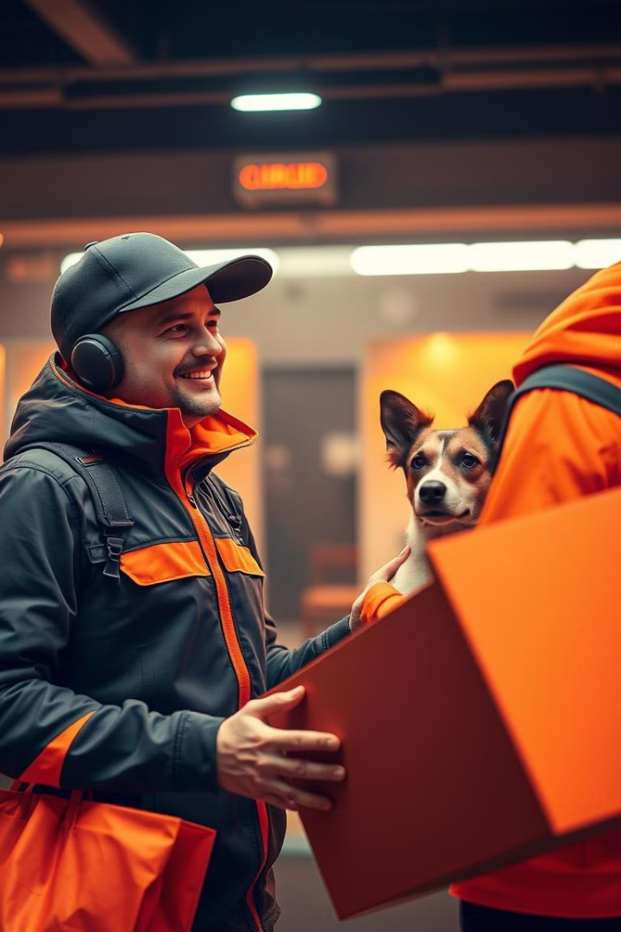
Addressing Key Challenges in the Delivery Industry
1
Language Barriers
2
Pet Safety
Facilitates communication between customers and delivery personnel who speak different languages.
Alerts delivery personnel to potential pet threats, ensuring their safety.
3
Privacy Concerns
Protects customer privacy by providing an anonymous communication channel.

Slide 4

Data Privacy and Security Concerns
Data Collection
Regulatory Compliance
Gathering and managing detailed personal information raises concerns about data privacy and security.
Compliance with data protection regulations like GDPR could pose significant challenges.
Practicality
The practicality of gathering and managing such detailed personal information needs careful consideration.

Slide 5

Industry Insight: Growth and Challenges
1
Exponential growth driven by consumer behavior changes, reliance on technology, and convenience demand.
2
Communication issues due to language barriers, causing misunderstandings.
3
Risks of pets biting delivery personnel.
4
Integration complexities and high costs for collaborating with existing delivery apps.

Slide 6





SWOT Analysis: Strengths, Weaknesses, Opportunities, and Threats
Strengths
Weaknesses
Opportunities
Threats
Addresses language barriers for better communication. Alerts delivery personnel to pet threats. Protects customer privacy with unique phone numbers.
Regulatory and data privacy compliance challenges. Complex and costly implementation with existing apps. Requires significant marketing and user education.
Partnerships with delivery apps to expand reach. Rising consumer preference for privacy-focused solutions. Leveraging emerging technology for improved communication and data management.
Regulatory scrutiny on data privacy. Competition from existing services offering similar features. Cybersecurity risks from handling sensitive data.

Slide 7






PESTEL Analysis: Political, Economic, Social, Technological, Environmental, and Legal Factors
Political
1
Growing global data privacy regulations; supportive tech policies in some regions.
2
Economic
Booming delivery market offers financial opportunities; economic recessions may impact service adoption.
3
Social
Growing awareness of pet safety and privacy concerns; language diversity increases demand for translation services.
4
Technological
AI and machine learning advancements can enhance communication; virtual solutions improve adoption.
5
Environmental
Opportunities for eco-friendly collaboration; compliance with environmental regulations on data storage.
6
Legal
Compliance with data protection laws is crucial; legal liabilities arising from customer disputes.

Slide 8




Business Strategies: Partnering, Marketing, and Technology
Partnerships
Marketing
Partner with delivery apps to integrate the service directly into their platforms.
Launch a strong marketing campaign focusing on privacy and safety.
Technology
Invest in state-of-the-art translation technology for accurate communication.

Slide 9

Real-World Cases: Misuse of Customer Mobile Numbers
63
419
Stolen Phones
Fraudulent Calls
Delivery personnel in Surat stole 63 mobile phones worth ₹13.60 lakh.
A woman and her accomplices in Mumbai defrauded 419 customers of ₹4.83 lakh.
27L
1,000+
Fake Call Centre
Jamtara Gang
A fake call centre in Delhi defrauded victims of ₹27 lakh in one month.
A gang in Jamtara cheated over 1,000 people across India.

